Slide 1
DATA ANALYST NANODEGREE
Session 2
Conducted by: Hamza
Notes:
https://udacity.zoom.us/j/7991233356
‹#›

Slide 2
Agenda
Github (fork - pull request)
Joins
Set theory
Subquery
CTEs
Project

Slide 3
SLACK / SUPPORT / REPOS
https://join.slack.com/t/egfwd-t3-october-22/shared_invite/zt-1hk7owwgy-6~9jmz47ud9xTj_O3DS4qg
fwd-support@udacity.com
https://github.com/santarabantoosoo/Data-Analysis-NanoDegree-2.0
Notes:
‹#›

Slide 4
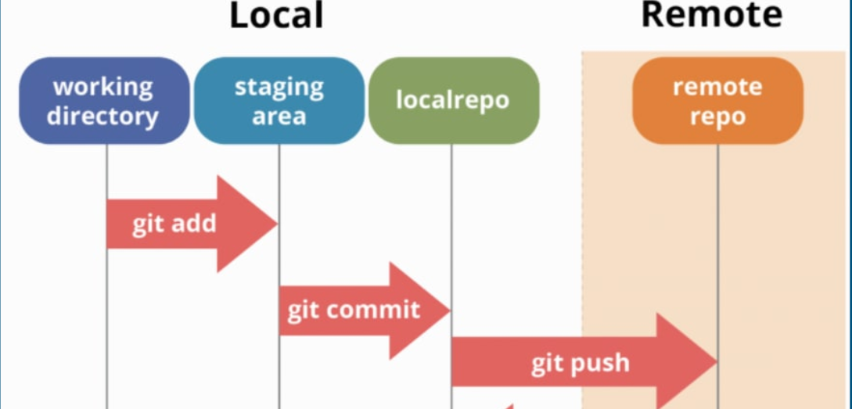
GIT FLOW Recap

Slide 5
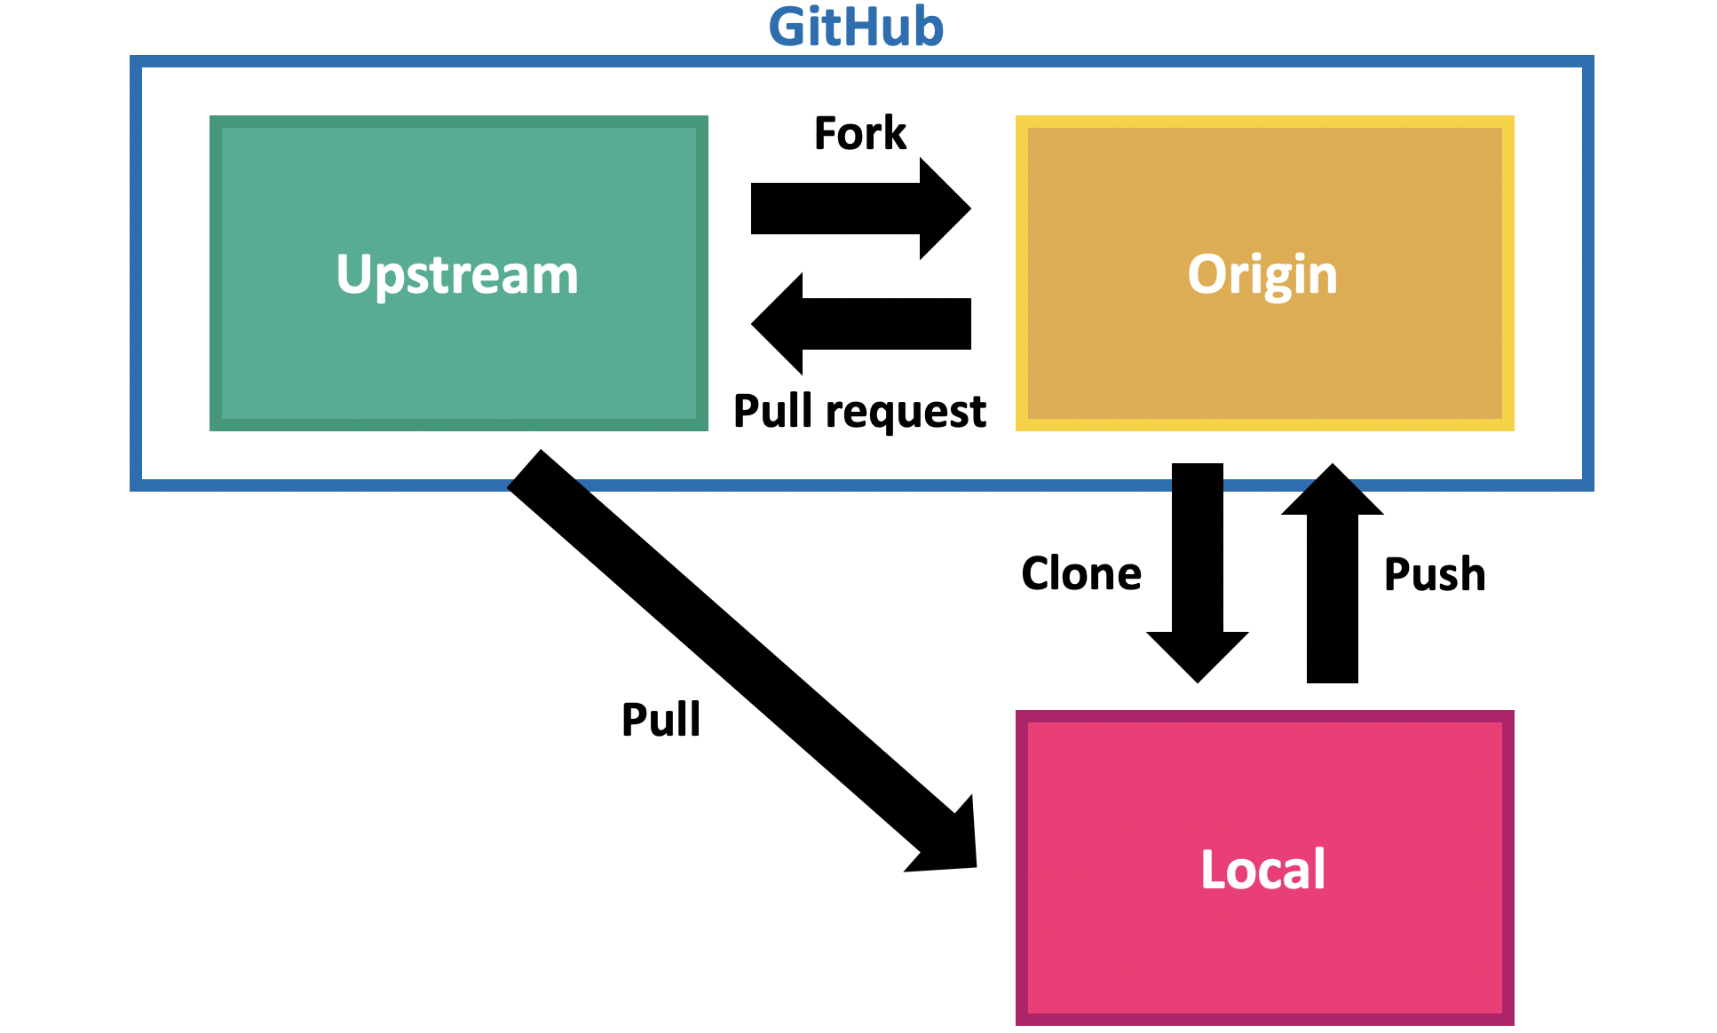
Let’s collaborate
Notes:
https://www.tomasbeuzen.com/post/git-fork-branch-pull/

Slide 6
GitHub Concepts - DataCamp Learn
https://app.datacamp.com/learn/courses/github-concepts?utm_source=customerio&utm_medium=email&utm_campaign=221018_1-newsletter-ab_2-mix_3-all_4-na_5-na_6-dc-insights_7-na_8-emal-ci_9-na_10-bau_11-email&utm_content=blast&utm_term=newcourse

Slide 7


Slide 8
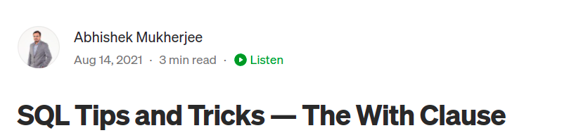
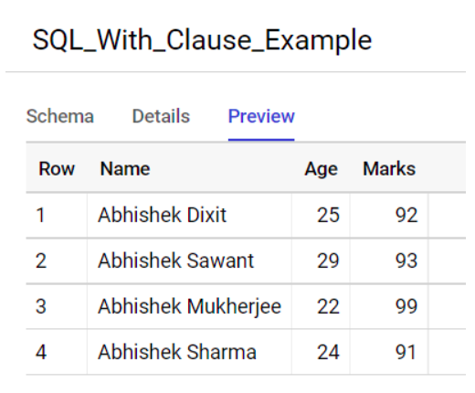
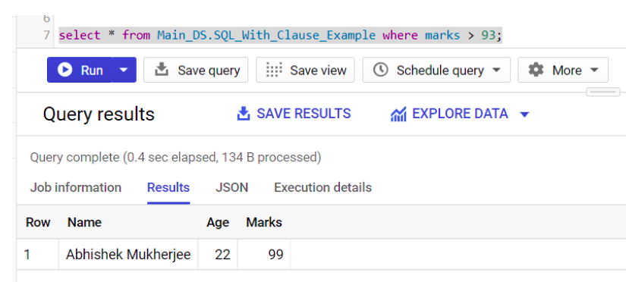
https://medium.com/@abhishekblogger/sql-tips-and-tricks-the-with-clause-1a78af758af7

Slide 9
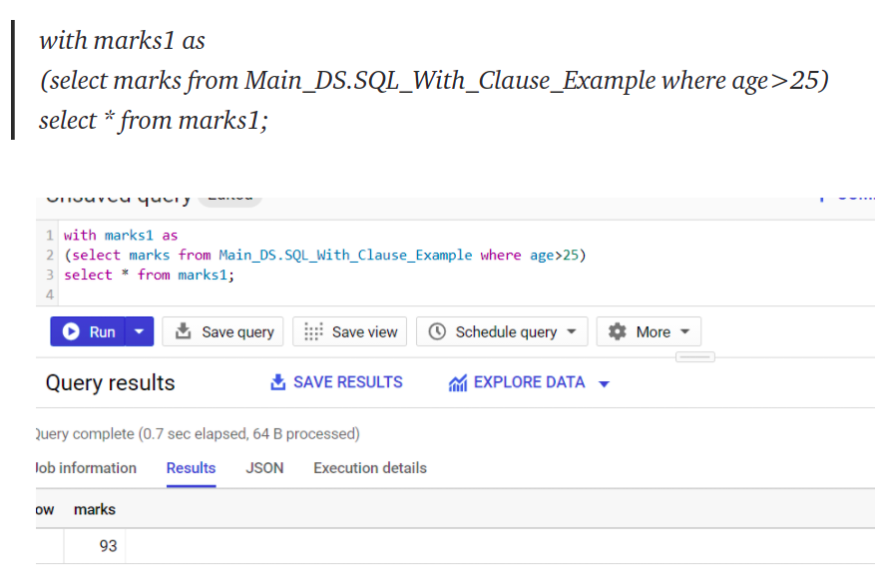
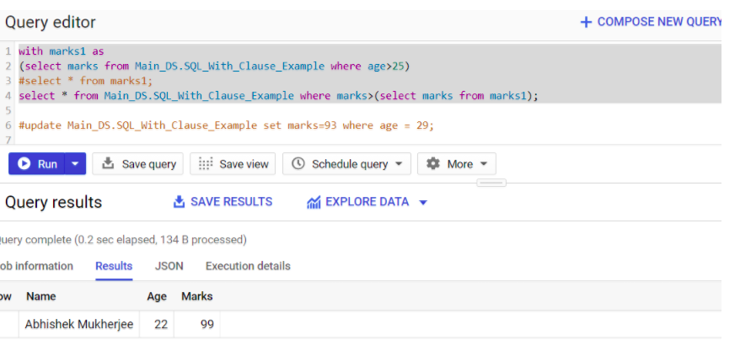

Slide 10

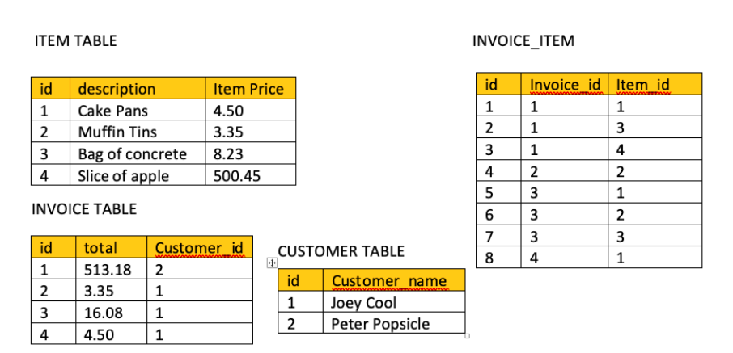
How many invoices are associated with the customer Joey Cool and how many of each item did he purchase?
https://medium.com/@jeremiahlutes/using-with-in-sql-10617d0a1d0c

Slide 11
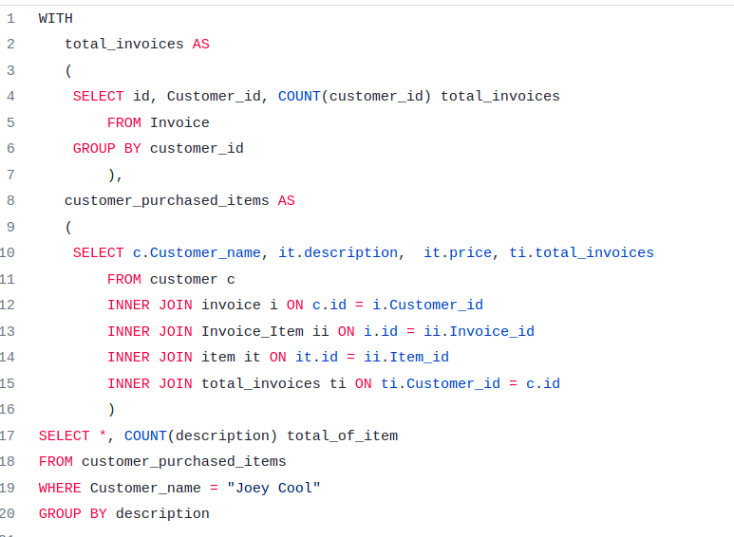

Slide 12
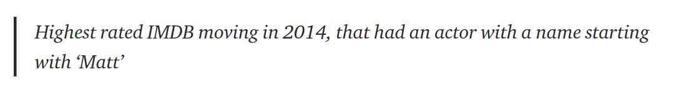
Good example
https://towardsdatascience.com/using-ctes-to-improve-sql-queries-dfcb04b7edf0

Slide 13
Consider adding case statements from SQL intermediate course datacamp

Slide 14
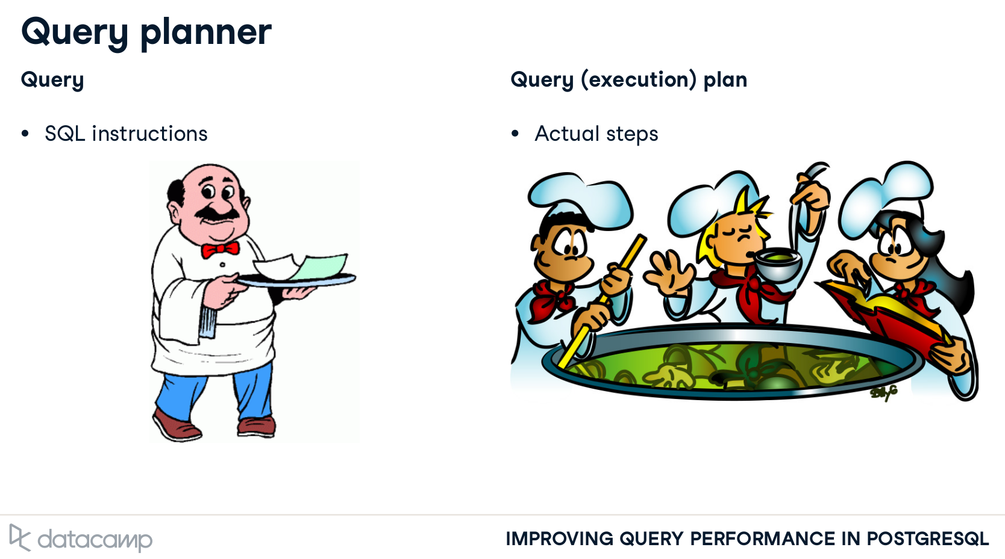
U ORDER – planner optimizes
لو خنقته - هيخنقك
Notes:
JUST LIKE A RESTAURANT, Ur meal is not prepared in the same way u ordered.
maybe u order the meat first and then the appetizer. However, u will be presented with appetizer first.

Slide 15
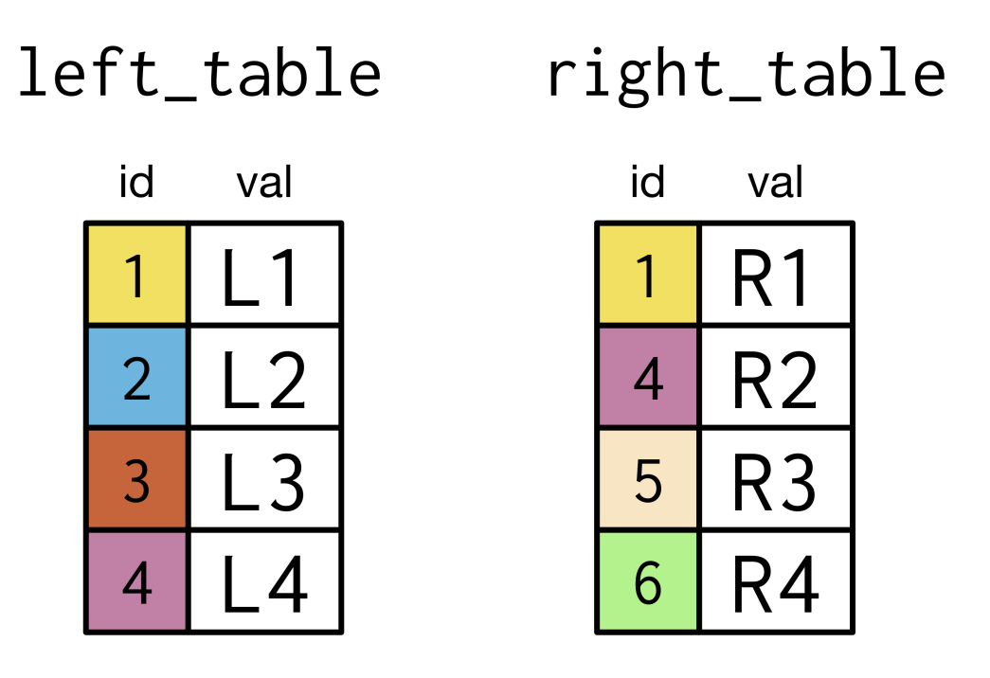
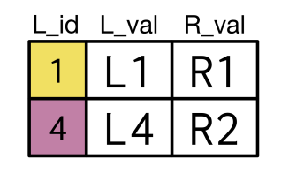
Joins
Which join type?

Slide 16
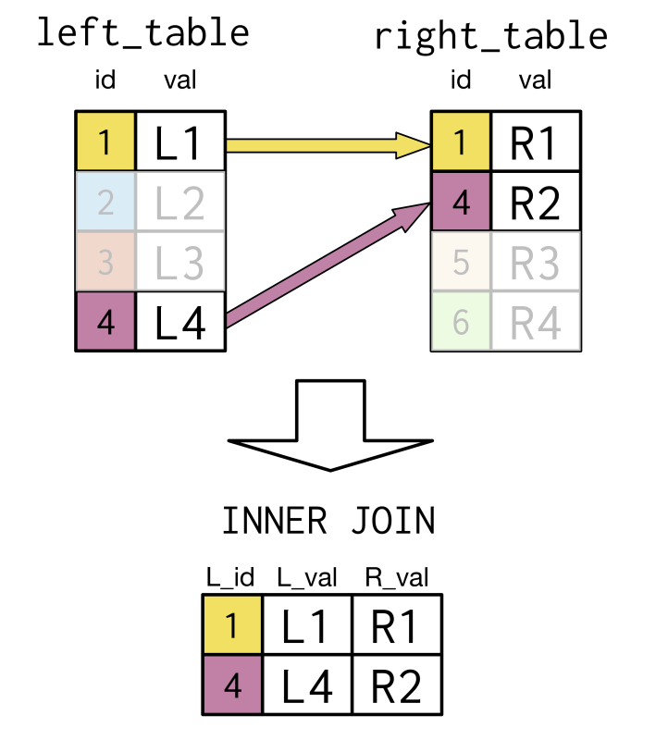
Solution

Slide 17
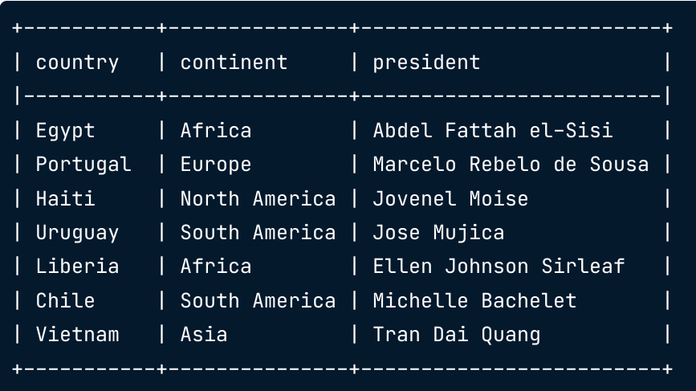
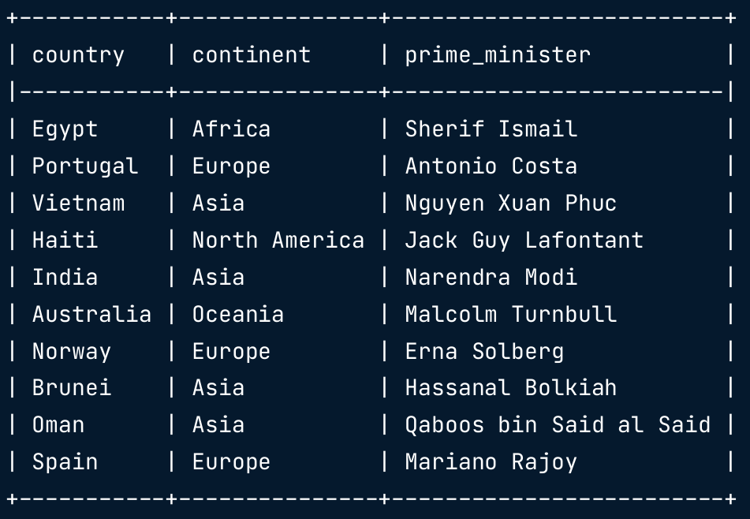
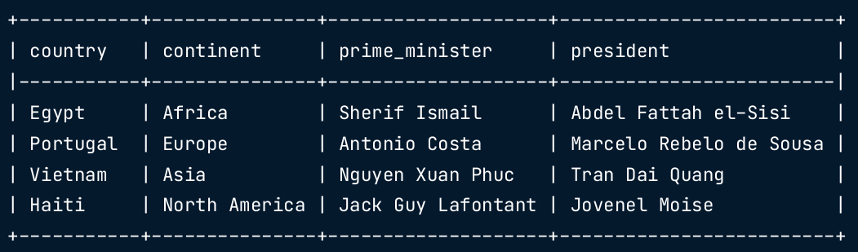
How to join?

Slide 18
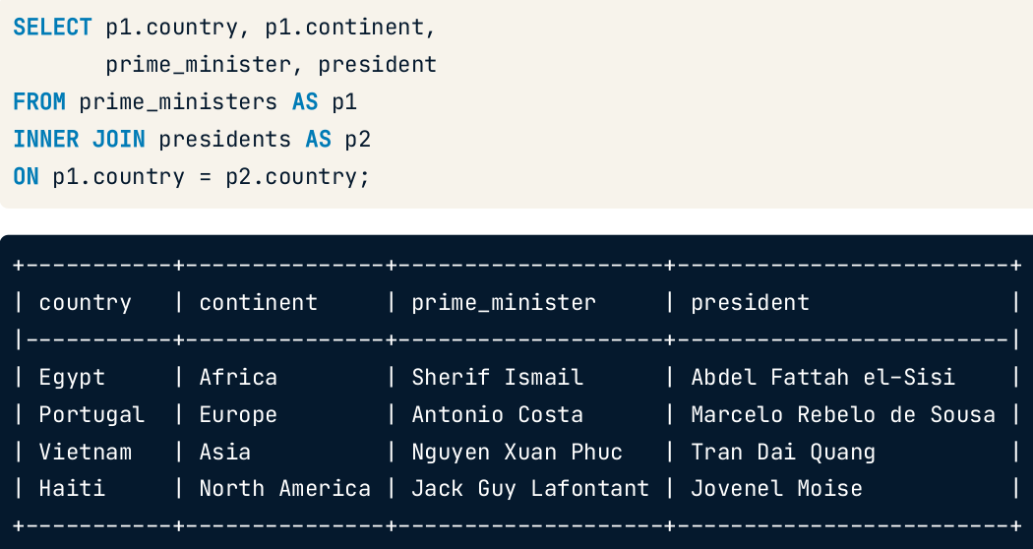
Solution
Other solutions?

Slide 19
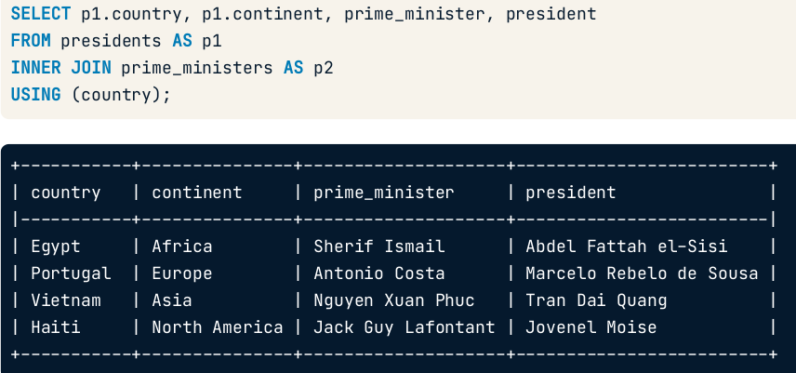
Using?
with USING, the joining column is returned only once.
When will it fail?

Slide 20
Using?
Different spelling
When will it fail?

Slide 21
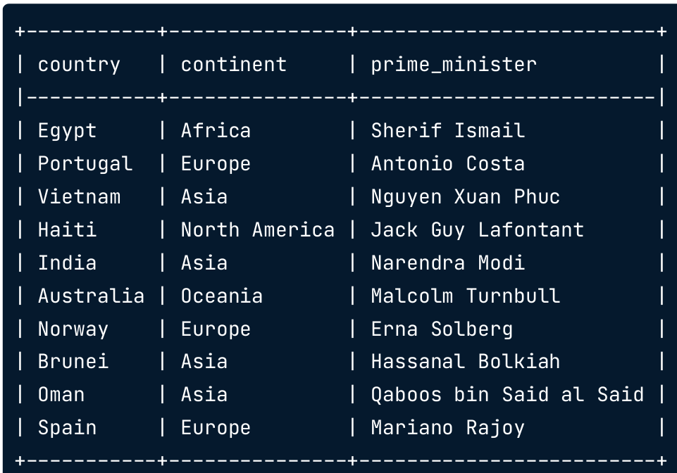
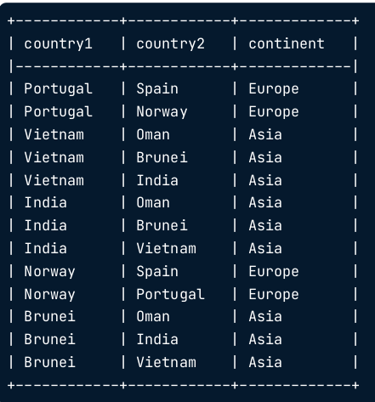
How to get there?
Country pairs within the same continent
similar examples – BMT siblings

Slide 22
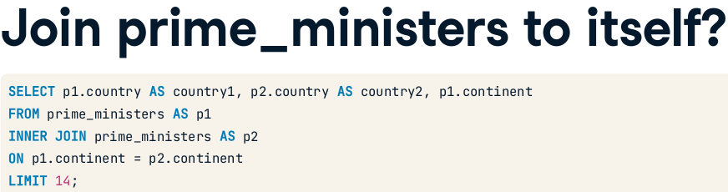
Solution
Anything missing?

Slide 23
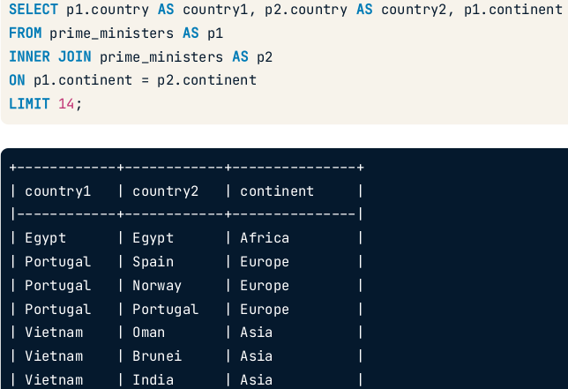
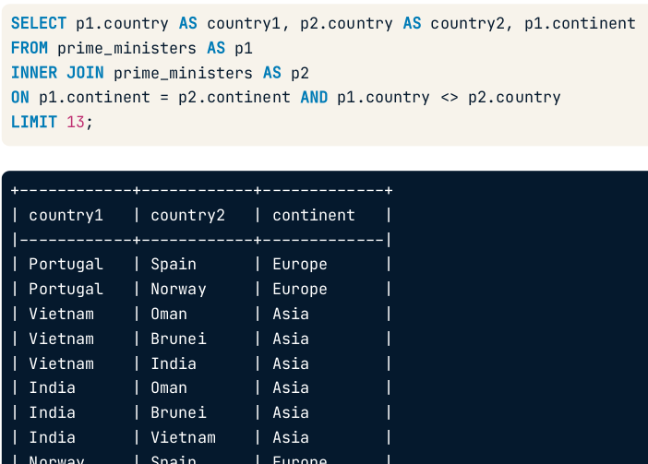
Self-join
No repetition!

Slide 24
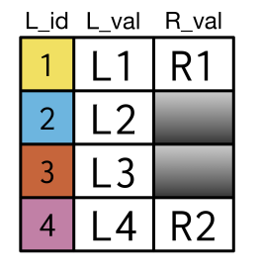
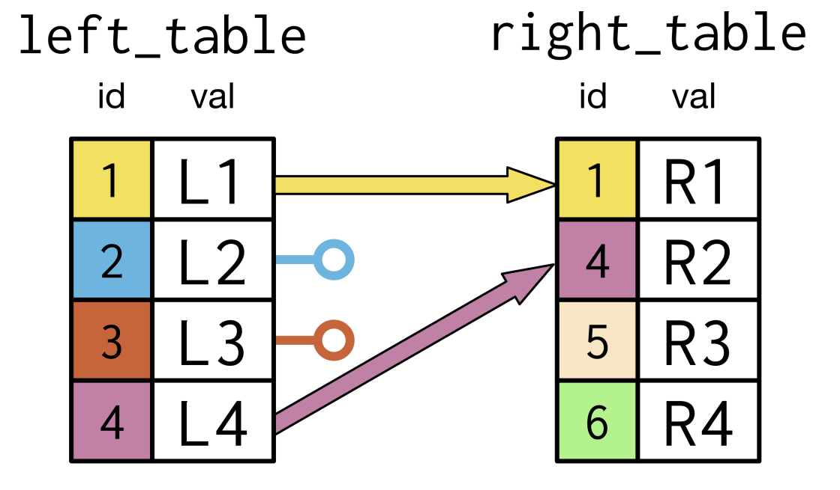
Which join?

Slide 25
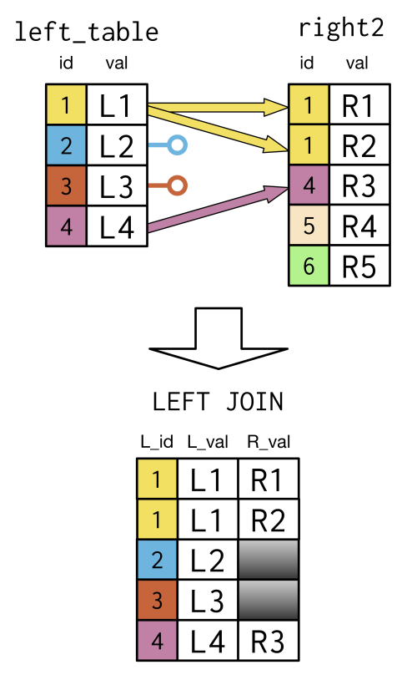
Solution

Slide 26
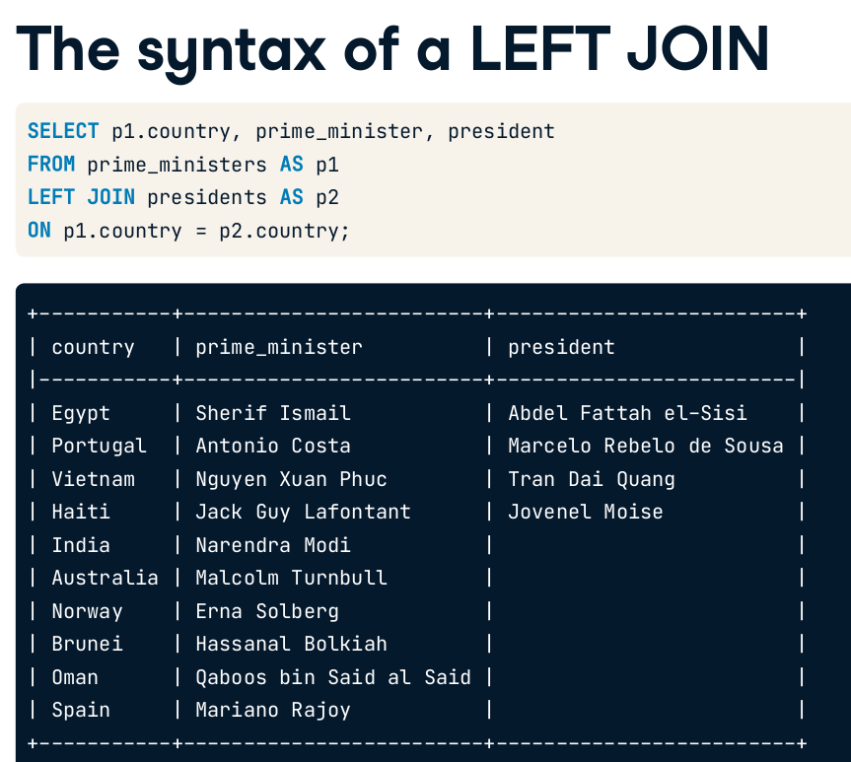
Notice the NULLs

Slide 27
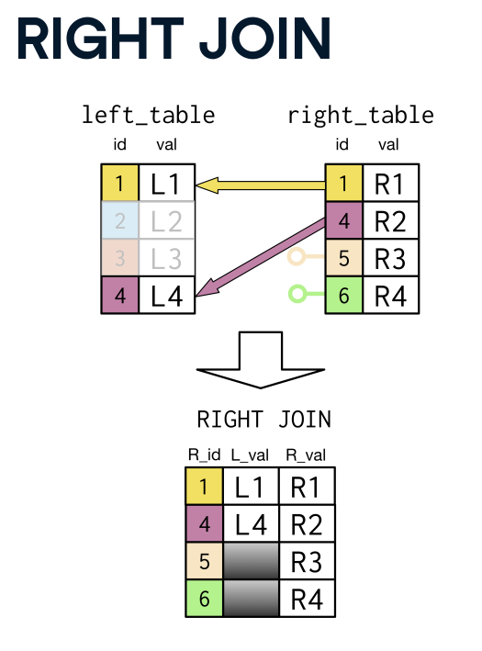
Familiar?

Slide 28
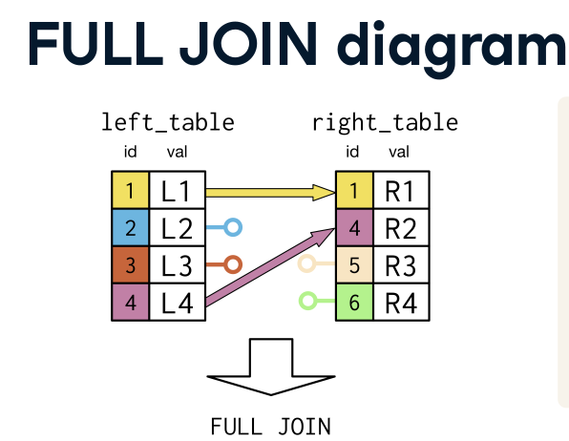
What to expect?
How many rows?
Where to expect NULL?

Slide 29
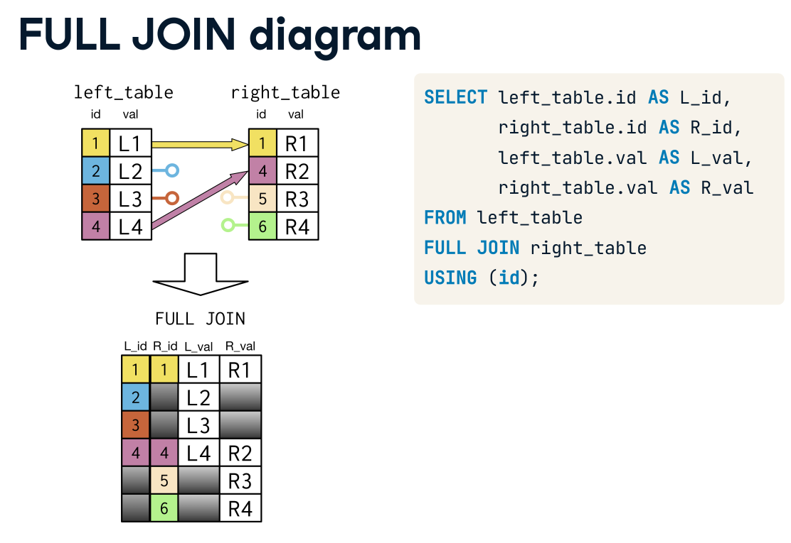
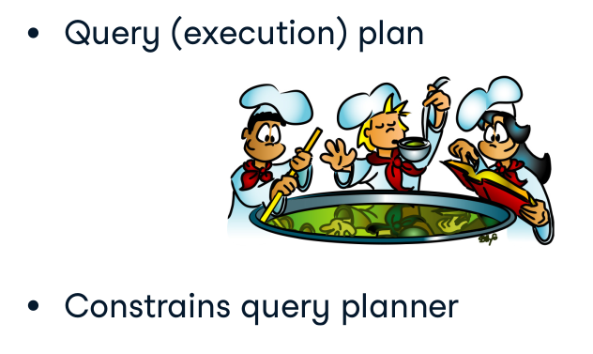
FULL JOIN = FULL OUTER JOIN

Slide 30
Full join?
For each country, get the president and prime minister

Slide 31
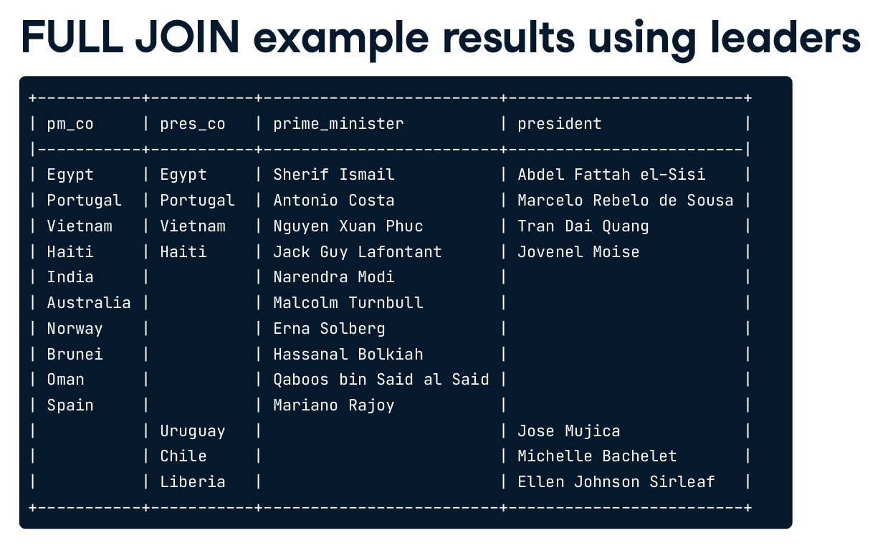
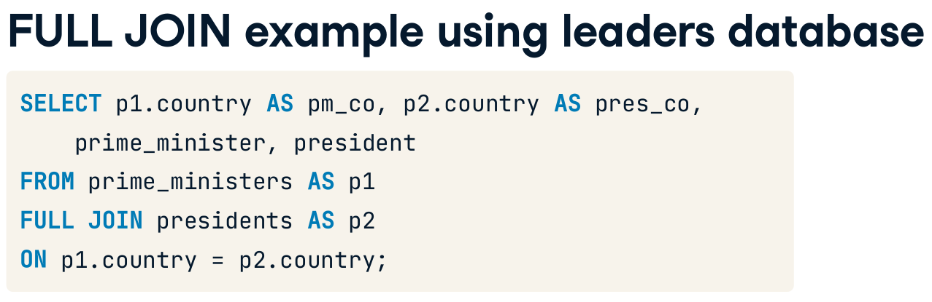
Solution

Slide 32
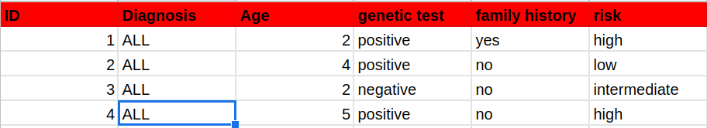
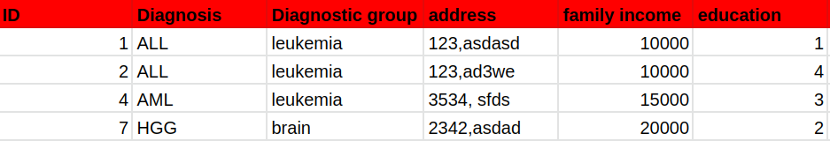
which join to choose?
Effect of risk factors on ALL patients’ outcome

Slide 33
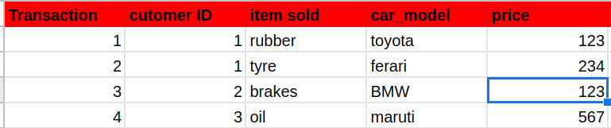

Search for datasets and decide on join type

Slide 34
What if?
Each president should meet each prime minister?

Slide 35
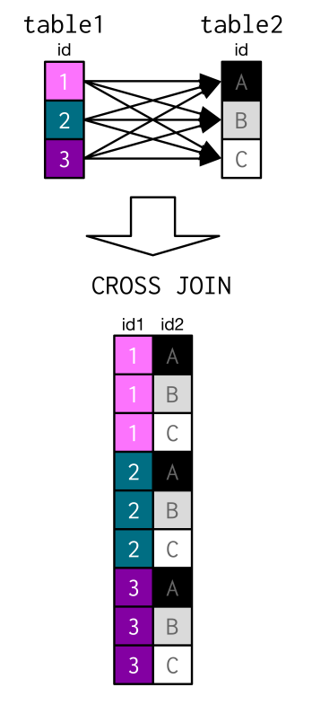
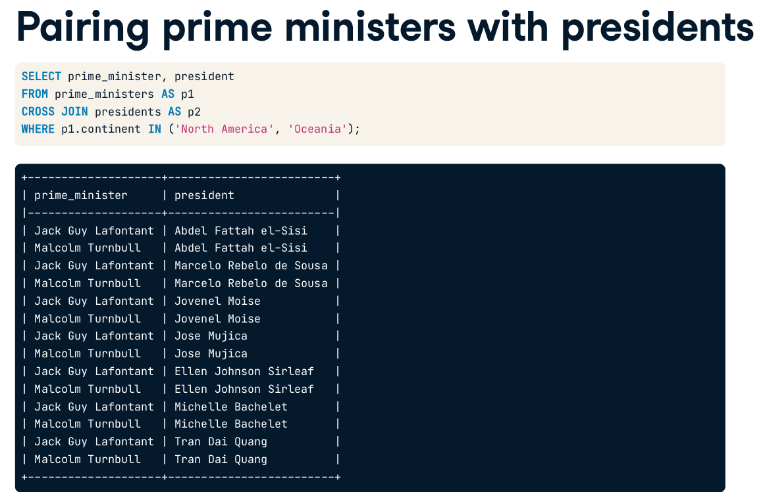
Cross join
Notes:
Difference between Natural join and Cross join in SQL - GeeksforGeeks
https://www.geeksforgeeks.org/difference-between-natural-join-and-cross-join-in-sql/

Slide 36
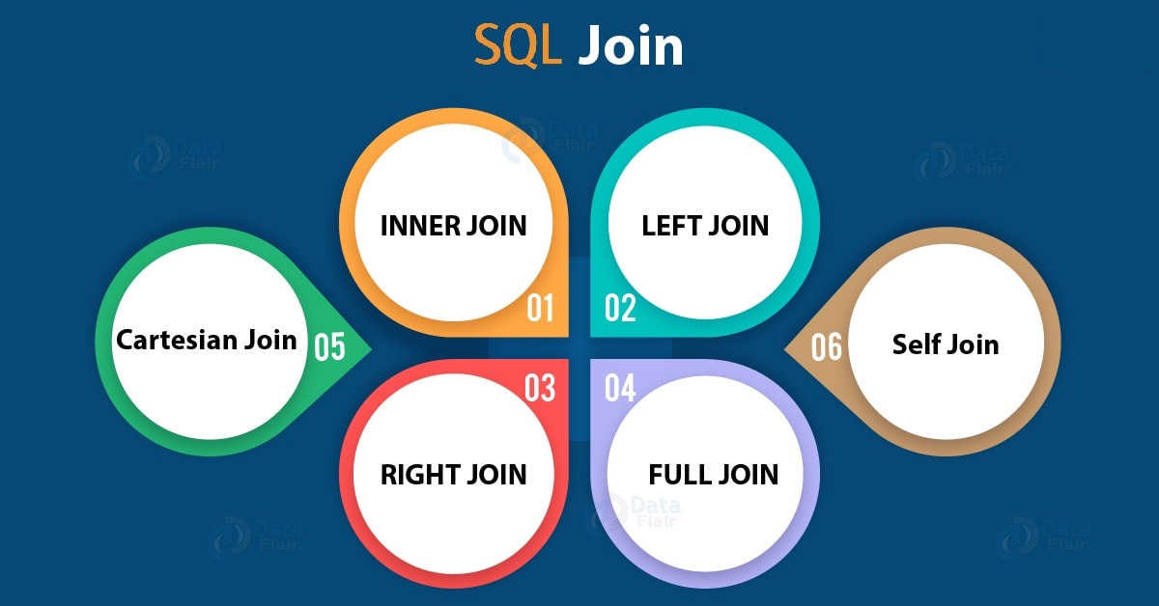
Recap
what about JOIN?
Cross join
Notes:
JOIN is inner JOIN

Slide 37

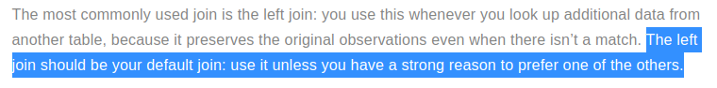
Recap
JOIN
Cross join
Notes:
JOIN is inner JOIN

Slide 38

Challenge
(1 or 2) and 3
Average Population of Each Continent | HackerRank
https://www.hackerrank.com/challenges/average-population-of-each-continent/problem
African Cities | HackerRank
https://www.hackerrank.com/challenges/african-cities/problem?isFullScreen=true
Top Competitors | HackerRank
https://www.hackerrank.com/challenges/full-score/problem?isFullScreen=true
Notes:
In MySQL, how CEILING() and FLOOR() functions are different from ROUND() function?
https://www.tutorialspoint.com/In-MySQL-how-CEILING-and-FLOOR-functions-are-different-from-ROUND-function#:~:text=ROUND()%20function%20rounds%20the,%2C%20towards%20zero%2C%20always%20down.
SELECT s.hacker_id, h.name
FROM Submissions s
INNER JOIN Challenges c ON s.challenge_id = c.challenge_id
INNER JOIN Difficulty d ON c.difficulty_level = d.difficulty_level
INNER JOIN hackers h ON h.hacker_id = s.hacker_id
WHERE s.score = d.score
GROUP BY s.hacker_id, h.name
HAVING count(*) > 1
ORDER BY count(*) DESC, s.hacker_id ASC

Slide 39
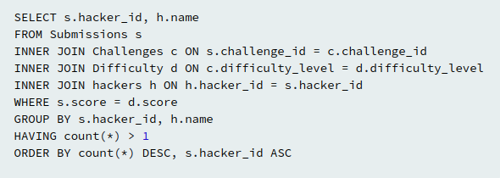
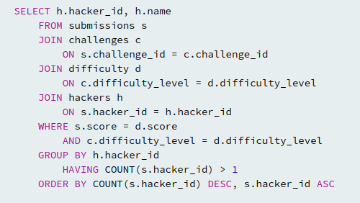
which is better?
Notes:
difficulty level not needed

Slide 40
which is better?
INNER or LEFT JOIN?
Notes:
difficulty level not needed
LEFT OR INNER DOESN’T MATTER

Slide 41
which is better?
GROUP BY h.name?
Notes:
difficulty level not needed
LEFT OR INNER DOESN’T MATTER
h.name is needed because u have it in the select statement

Slide 42
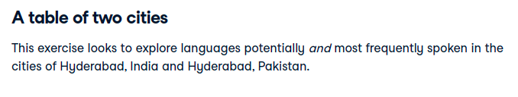
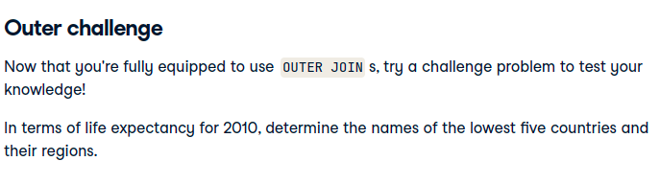
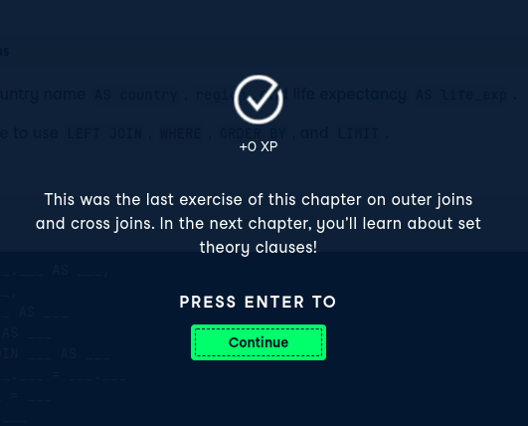
Challenge!
https://campus.datacamp.com/courses/joining-data-in-sql/outer-joins-and-cross-joins?ex=12

Slide 43
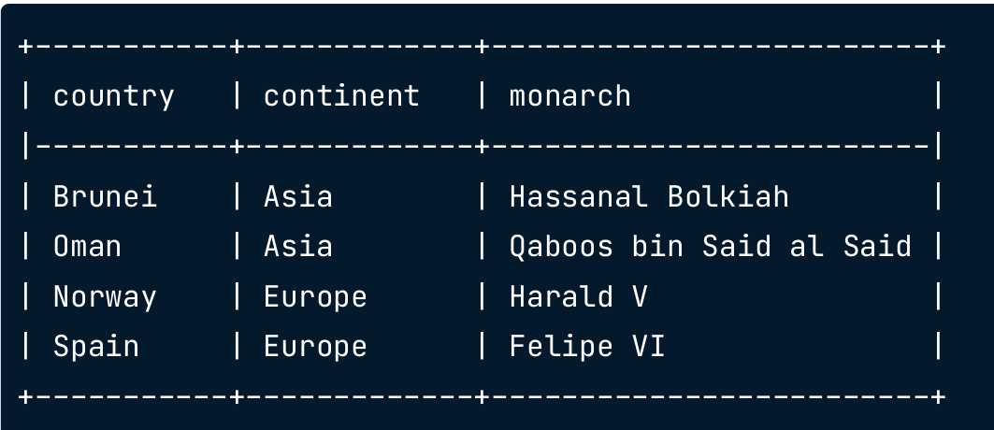
How to combine?
combine into a single table with the column name “الراس الكبيرة”

Slide 44
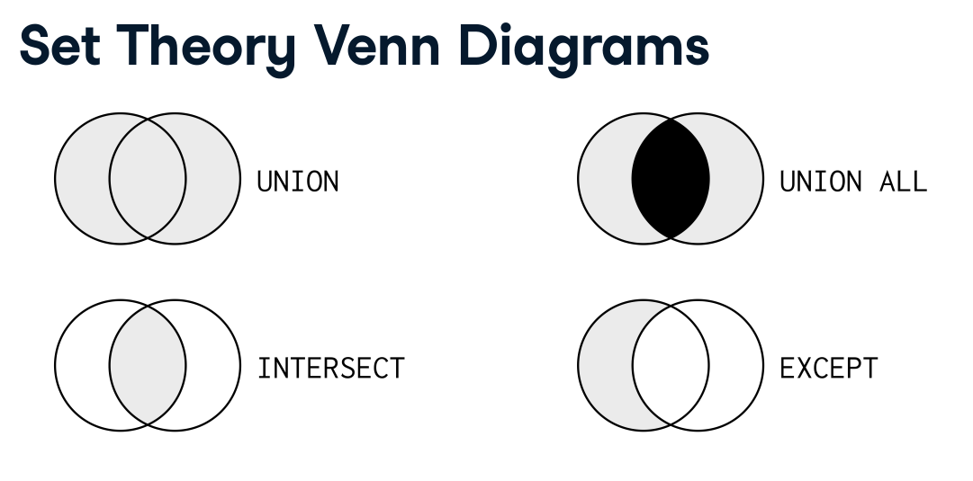

Slide 45
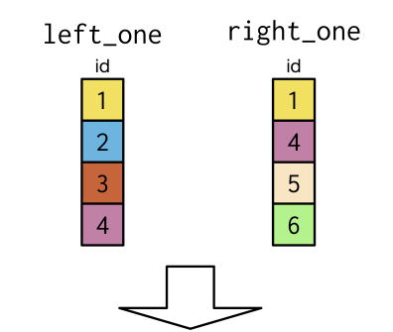
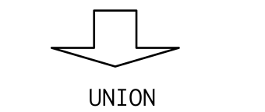

Any difference?

Slide 46
How to combine?
combine into a single table with the column name “الراس الكبيرة”

Slide 47





Slide 48


UNION VS UNION ALL?

Slide 49


Slide 50


INTERSECT.. Why empty?

Slide 51
Why is that?
Selects countries that have both president and prime minister
Both president and prime minister with same name

Slide 52


EXCEPT
Notes:
has a monarch who is different from a prime minister

Slide 53

What joins and sets did we use?

Slide 54

Duplicates
One table has duplicate keys
Notes:
one to many relationship

Slide 55


Slide 56

Duplicates
Both tables have duplicate keys

Slide 57




Slide 58
which is better?
INNER or LEFT JOIN?
Notes:
difficulty level not needed
LEFT OR INNER DOESN’T MATTER

Slide 59


How to solve?
Select from left table, countries that had independence before 1800

Slide 60
How to solve?
Select from left table, countries that had independence before 1800
u need all columns from left table and none from right table?
Notes:
semi join will solve this. It will keep the left table as is.

Slide 61
How to solve?
Select from left table, countries that had independence before 1800
Duplicates?
u need all columns from left table and none from right table?
Notes:
semi join will solve this. It will keep the left table as is.
again semi join will get only a single entry from 2nd table if u have duplicate IDs (it just checks if ID IS PRESENT)

Slide 62
Duplicates
One table has duplicate keys
Notes:
one to many relationship

Slide 64
Duplicates
Both tables have duplicate keys

Slide 66


HARD CODED
WHERE country IN [‘Portugal’, ‘Spain’]

Slide 67

Connecting the dots

Slide 68


Anti-join

Slide 69

Recap
Notes:
Here I filter based on the second table. I don’t include anything from the second table.

Slide 70

Small steps again
Find Asian countries below average `fert_rate`

Slide 71


2 small steps
Output of inner query?
Notes:
scalar

Slide 72
2 small steps
AND fert_rate < 2.28
Output of inner query?
Notes:
scalar

Slide 73

Combine!

Slide 74



Conclusion

Slide 75


Slide 76

Subquery Within SELECT
SCALAR

Slide 77



How to create a column with total number of matches of all seasons?
Can we use group by?

Slide 78


Manual solution

Slide 79

Automatic solution?
Can we do even better?
Notes:
window functions

Slide 80
Use cases

Slide 81


What is the expected output?
For season 2011/2012, get total goals for each match and get the deviation from the overall average for same season.

Slide 82

How to solve?
For season 2011/2012, get total goals for each match and get the deviation from the overall average for same season.
Expected output

Slide 83


Hardcoded or automatic?
What if we removed the 2nd WHERE?

Slide 84

challenge
https://campus.datacamp.com/courses/data-manipulation-in-sql/short-and-simple-subqueries?ex=9
https://campus.datacamp.com/courses/data-manipulation-in-sql/short-and-simple-subqueries?ex=10

Slide 85


Slide 86
How to solve?
maximum percentage of women in parliament for each continent listed in monarchs table.

Slide 87

Step1
From 2 tables?

Slide 88

Step 2
Duplicates?
Max perc?

Slide 89

Done
How did we decide which table should be the inner?
Is it
?
Notes:
I think it makes sense to get the distinct continents in the outer query. Then match each average to it later from the subquery.
In addition, if we did it the opposite way, the group by would be in the outer query.
In fact I am not sure

Slide 90

In the query execution plan, subqueries in SELECT and WHERE statements are analogous to joins, unlike FROM.

Slide 91



https://asktom.oracle.com/pls/apex/asktom.search?tag=regarding-subquery-terminology
https://learnsql.com/blog/inline-query-in-sql/#:~:text=The%20first%20difference%20is%20that,work%20as%20a%20single%20value.

Slide 92

Spare the first part

Slide 93




Slide 94



COMMON TABLE EXPRESSIONS
Notes:
Also named as
‹#›

Slide 95


WITH CLAUSE
WHERE / SELECT / FROM ??
Notes:
WITH clauses allow us to improve the structure of an SQL statement without polluting the database namespace.
As far as I understand, where is not possible.
SELECT is possible only with correlated subquery. (slow)
‹#›

Slide 96



Create average_salary table
JOIN
FROM?
Notes:
a query within the FROM clause is the same as a query inside a join clause

Slide 97

Create average salary table
JOIN
GET AG
Drawbacks?
Notes:
readability and speed

Slide 98

SOLUTION
Create average salary table
JOIN

Slide 99

OUTPUT

Slide 100

Basic syntax

Slide 101

Comparison

Slide 102
MULTIPLE WITH CLAUSES
+ location
Notes:
WITH clauses allow us to improve the structure of an SQL statement without polluting the database namespace.
As far as I understand, where is not possible.
SELECT is possible only with correlated subquery. (slow)
‹#›

Slide 103

Notes:
WITH clauses allow us to improve the structure of an SQL statement without polluting the database namespace.
As far as I understand, where is not possible.
SELECT is possible only with correlated subquery. (slow)
‹#›

Slide 104



One solution

Slide 105

Alternative solution
12 Lines
17 Lines

Slide 106





Slide 107


Slide 108



https://www.youtube.com/watch?v=Gm8N_yip0Ek
Window function?
Notes:
The same result can be obtained with window SQL functions and just one CTE, but we used multiple common table expressions here.

Slide 109
NESTED WITH CLAUSES
1- AVG salaries
2- Minimum of AVG salaries
Notes:
WITH clauses allow us to improve the structure of an SQL statement without polluting the database namespace.
As far as I understand, where is not possible.
SELECT is possible only with correlated subquery. (slow)
‹#›

Slide 110

NESTED WITH CLAUSES
Role with minimum of AVG salaries
Notes:
WITH clauses allow us to improve the structure of an SQL statement without polluting the database namespace.
As far as I understand, where is not possible.
SELECT is possible only with correlated subquery. (slow)
‹#›

Slide 111

NESTED WITH CLAUSES
Min of average salaries
Notes:
WITH clauses allow us to improve the structure of an SQL statement without polluting the database namespace.
As far as I understand, where is not possible.
SELECT is possible only with correlated subquery. (slow)
‹#›

Slide 112

More info
https://learnsql.com/blog/with-clause-is-awesome-sql/
Notes:
The WITH clause was introduced in SQL:1999 to define views that are only valid for the query they belong to.

Slide 113


Table Creation vs. CTEs

Slide 114
Common Table Expression(CTEs)
large or complex tables?
Notes:
the query planer materializes the CTE into a temporary table
temp tables are advantageous when working with large or complex tables that are resource intensive to query.

Slide 115

Temp table
What about CTEs?
Notes:
CTEs or subqueries are available for a single query
slow tables: creating a copy of slow to formulate table makes it faster to query

Slide 116

Convert to temp

Slide 117


Slide 118


Slide 119


Materialize a view!

Slide 120

Combining temp tables with CTE

Slide 121
Common Table Expression(CTEs)
large or complex tables?
Materialize a view!
Notes:
the query planer materializes the CTE into a temporary table
temp tables are advantageous when working with large or complex tables that are resource intensive to query.
CTE will always be executed once , even if it is referenced more than once.
https://stackoverflow.com/questions/43618692/is-cte-really-a-view

Slide 122


Table and temporary table

Slide 123


Notes:
https://stackoverflow.com/questions/11169550/is-there-a-performance-difference-between-cte-sub-query-temporary-table-or-ta

Slide 124



Slide 125


How many records
Words in script
Words in dictionary
Join and get the average word length

Slide 126

Alternative solution

Slide 127

Spare this – till u identify
Notes:
https://projects.datacamp.com/projects/1413

Slide 128

Breakout rooms
https://www.hackerrank.com/challenges/challenges/problem

Slide 129



Slide 130

Breakout rooms
https://projects.datacamp.com/projects/1413
Prerequisites:
1- Joins
2- Set theory
3- Subqueries

Slide 131
TO DO
revise optimize query performance SQL datacamp
Sql pitfalls
Resources
Subqueries from sql learning
Demo using mode or psql or pgadmin4
Datacamp projects
Subquery vs. JOIN | LearnSQL.com
https://learnsql.com/blog/subquery-vs-join/
SQL for Data Analysis: Subquery vs. CTE | by Aaron Zhu | Towards Data Science
https://towardsdatascience.com/sql-for-data-analysis-subquery-vs-cte-699ef629d9eb
“Common Table Expression(CTE) in SQL Server” | by Smita Gudale | Medium
https://medium.com/@smitagudale712/common-table-expression-cte-in-sql-server-c6dfb8a461ee
How to use CTEs in SQL. How to use a Common Table Expression to… | by Jason Lee | Towards Data Science
https://towardsdatascience.com/using-ctes-to-improve-sql-queries-dfcb04b7edf0
Basic SQL Techniques For Data Analysis | by Ektamanvar | Mar, 2022 | Medium
https://ektamanvar23.medium.com/sql-techniques-for-data-analysis-92d85de3c32a
Window Functions in SQL: Aggregating Values | by Michael Grogan | Towards Data Science
https://towardsdatascience.com/window-functions-in-sql-aggregating-values-278f2bdb545
Common Table Expressions: When and How to Use Them | Tutorial by Chartio
https://chartio.com/resources/tutorials/using-common-table-expressions/
MySQL | Recursive CTE (Common Table Expressions) - GeeksforGeeks
https://www.geeksforgeeks.org/mysql-recursive-cte-common-table-expressions/
What if ... you had to use parameters in SQL queries - Castor Blog
https://www.castordoc.com/blog/what-if-you-had-to-use-parameters-in-sql-queries

